Slide 1
Dealing with Phishing issue
70351 Tomohiro Matsuyama

Slide 2

What is Phishing?
Phishing
A computer program which mimics human behavior by learning various data and insights
Phishing is a cybercrime in which a target or targets are contacted by email, telephone or text message by someone posing as a legitimate institution to lure individuals into providing sensitive data such as personally identifiable information, banking and credit card details, and passwords.

Slide 3
Why Should you care?
How About Lost Revenue, Cyber Attacks, Private Data Breaches, & Reputation Trashing?
The risk of phishing is hidden – because the user believes they are responding to a legitimate email, often not realizing it was an attack until hours, days, or even weeks after the event.
As the sophistication and frequency of these attacks continue to evolve, unprepared businesses become easy targets, giving hackers access to a plethora of confidential information.

Slide 4
What’s the expected rise in occurrence?
Upon evaluating data from previous years, the shear number of phishing attempts our clients receive has continued to rise. By the end of 2017, an average user was receiving 16 phishing emails per month. Additionally, in a study conducted by Wombat Security, 76% of organizations say they were impacted by phishing attacks in 2017.

Slide 5
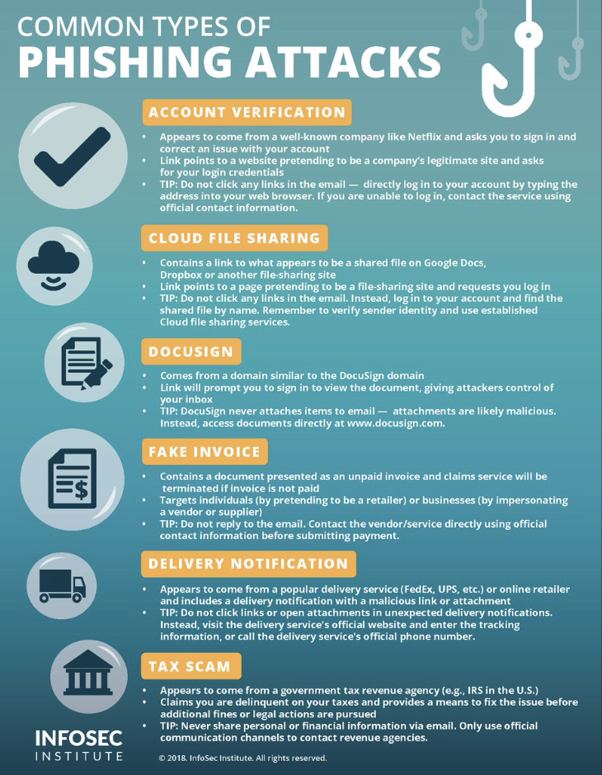
Common types of phishing attacks

Slide 6
What steps can organizations take?
Include security awareness in your organisation’s culture. By raising awareness of the signs and dangers of phishing attacks, the employees will be able to identify them; be less likely to fall for them; or at least be able to flag an issue and report it to you so you can take timely steps to contain the incident.
Use spam filters or secure email gateways to block deceptive emails from reaching VPS employees. Spam filters and secure email gateways monitor incoming emails for unwanted or fraudulent content. Once identified, they prevent them from ever reaching an employee’s inbox.
.

Slide 7
What steps can organizations take 2?
Enable multifactor authentication (MFA) and anomaly login policies. Even if an employee provides information to a scammer, these measures decrease a scammer’s ability to gain access to the employee’s work account and increase your ability to detect and respond to incidents in a timely manner.
Report phishing attempts to the authorities. You should report phishing attempts to the Government Cyber Incident Response services by emailing to them who can help you respond to the incident. You should also report security incidents by emailing a copy of their incident notification them or contacting them for privacy advice.
.

Slide 8
What steps can employees take ?
Watch out for fake links or attachments. Where you suspect an email to be a phishing attempt, contact your IT team. Do not open any attachments, click any links or forward the email to another device.
Do not provide information to unverified sources. If you are unsure about whether you should be providing your information, check with your Privacy Officer or IT team. If the email is from someone familiar but the contents appear surprising or suspicious, contact them on the phone number you already hold to verify if they actually sent it.
If you receive a phishing email, notify your IT department. If you think you have fallen for a phishing attempt or notice suspicious activity on your device, immediately disconnect from the internet and notify your IT team. Do not shut down or restart your device.
.

Slide 9
Risk management

Slide 10
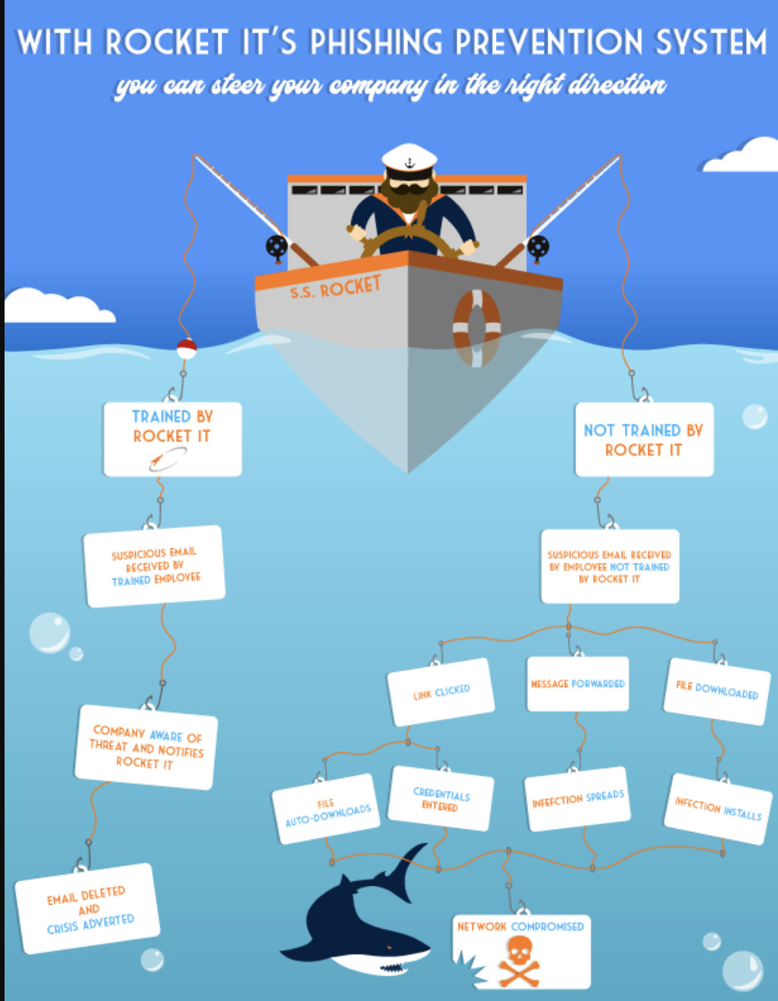
Risk Management
E.g: With Rocket Its Prevention System .
Rocket IT focuses on providing highly actionable preventions,
affording clients the opportunity to turn the tide on phishing attacks.
The core problem with phishing emails is many users,
particularly less technical users, don’t realize when they’re being phished.
Rocket IT uses a training platform, that sends out harmless, simulated phishing emails.
It then tracks the number of ‘clickers’, users that fell for the fake trap and clicked the email,
allowing our team to effectively prevent future attacks.

Slide 11

Emerging, Affordable Security Platforms (Phishing Testing and Training)
Rocket IT focuses on providing highly actionable preventions, affording clients the opportunity to turn the tide on phishing attacks.
The core problem with phishing emails is many users, particularly less technical users, don’t realize when they’re being phished.
Rocket IT uses a training platform, that sends out harmless, simulated phishing emails. It then tracks the number of ‘clickers’, users that fell for the fake trap and clicked the email, allowing our team to effectively prevent future attacks.

Slide 12
Breach Notification, Loss of Data, Loss of Work Time, & Unexpected Expenses
The fallout of these attacks can be extreme. The following problems develop regularly:
Loss of work time of a week (or more).
Loss of data and files.
Loss of customer relationship / eroding customer trust.
Expensive remediation and security projects.
Major stress and unnecessary emotional burdens.
When it comes down to it, phishing attacks can be harrowing. While, in a perfect world these events would cease to exist, Rocket IT believes the most effective response is to embrace this reality, set up systems and training to prevent it, and establish a recovery plan.

Slide 13
Conclusion
Is There Any Hope?
Fortunately, the IT industry is not sitting on its collective laurels – a massive amount of time and money has been invested into researching the most effective methods of preventing these attacks. Through these innovations, Rocket IT has meticulously refined its systems, tools and techniques, giving clients effective means to prevent security breaches.

Slide 14
THANK YOU

Slide 15
Reference
https://rocketit.com/phishing-threat-test-prevention/
https://ovic.vic.gov.au/privacy/resources-for-organisations/phishing-attacks-and-how-to-protect-against-them/

